Slide 1
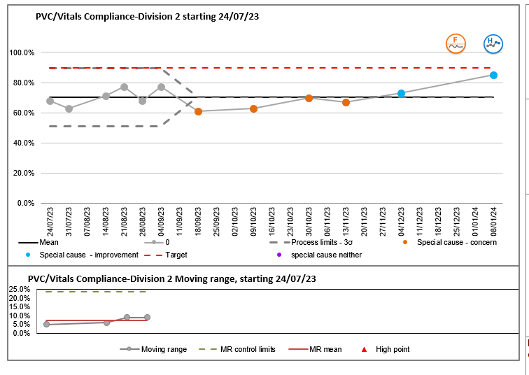
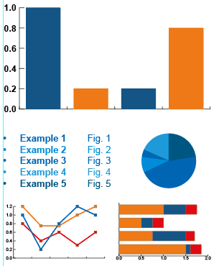
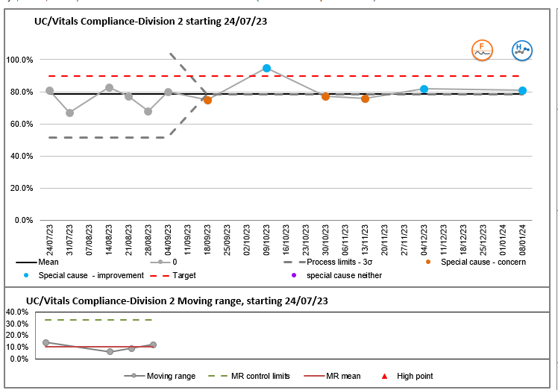
A24 007
Improving reporting of indwelling devices on Vitals
Kim Corbett Matron Infection Prevention
Abstract
The aim of this project was to increase compliance to 90% of all peripheral vascular cannulae (PVC) and urinary catheters (UC) are recorded on Vitals in all medical inpatient areas, excluding Emergency Portals (AMU, ED) by December 2023.
How many PVCs and UCs are insitu at time of audit.
How many PVCs and UCs are recorded on Vitals at time of audit.
Graphs / Charts to go here
Results
Compliance with recording PVC increased from 71% in December 2022 to 85% in January 2024.
Compliance with recording UC increased from 68% in May 2023 to 81% in January 2024.
Although this project did not achieve the original project aim of 90% of all peripheral vascular cannulae and urinary catheters are recorded on Vitals in all medical inpatient areas, excluding Emergency Portals (AMU, ED) by December 2023, it did show improvement on several wards. It raised the importance of ensuring that devices must be added to Vitals in a timely manner.
.
Infection Prevention Team
Corporate Division

