Slide 1
Walsall Healthcare NHS Trust
Annual General Meeting
Sir David Nicholson KCB CBE,
Chair

Slide 2
Welcome
Apologies received
Declarations of interest
Minutes of the previous Annual General Meeting held on 28 September 2022
Matters arising from the Minutes of the Annual General Meeting held on 28 September 2022

Slide 3
Professor David Loughton CBE,
Group Chief Executive

Slide 4
Welcome: another extraordinary year in the NHS
Key successes 2022/23:
  Opening of the new Urgent and Emergency Care Centre
  Robot arm-assisted hip and knee replacement surgery started
  Hundreds of patients supported through Virtual Wards
  One-stop head and neck imaging service introduced
  Legacy Mentor scheme to encourage staff retention and use skills of established workforce

Slide 5
Welcome: another extraordinary year in the NHS
Key challenges 2022/23:
  Major changes to the NHS landscape with the establishment of Integrated Care Systems (ICSs) and Integrated Care Boards (ICBs) on 1 July
  Workforce – recruitment and retention – remains an area of focus, as does staff morale set against cost-of-living crisis
  Money – financial constraints within the system began to bite this year
  Continued backlog in elective services – after-effects of the pandemic still being felt
  Growing demand on urgent and emergency care services – pressure to continually improve patient flow and create capacity

Slide 6
Our new joint strategy
  Our vision:
“To deliver exceptional care together to improve the health and wellbeing of our communities”
  Our new five-year strategy centres around the four Cs
  Walsall Healthcare’s values, chosen by staff, remain as Respect, Compassion, Teamwork and Professionalism

Slide 7
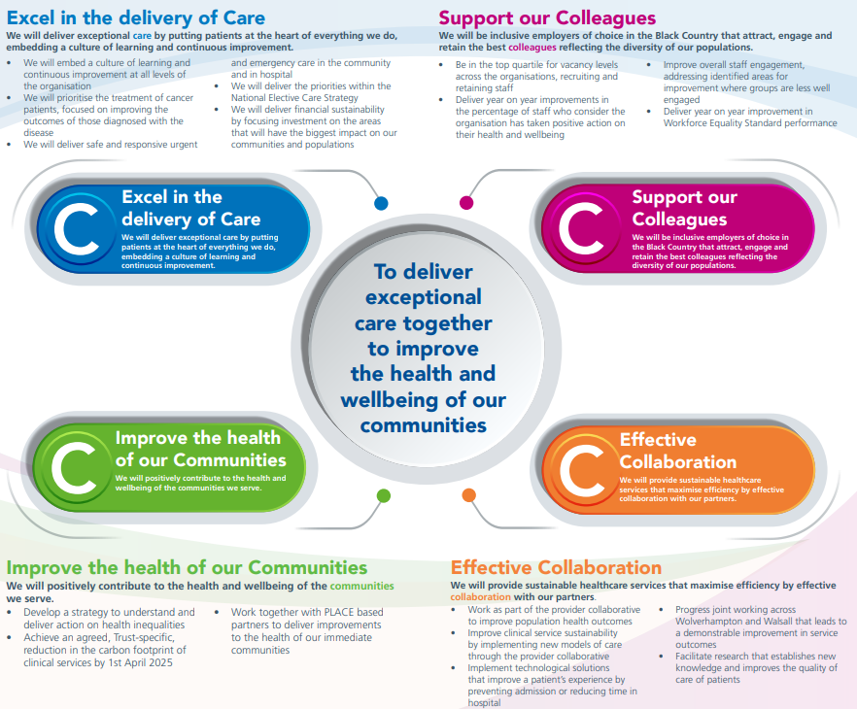
Our new joint strategy

Slide 8
Strengthening partnerships
  Our RWT and WHT joint work going from strength to strength – examples include Speech and Language Therapy, Infection Prevention and Control, Tissue Viability
  Efforts with system partners through ICB led to set up of:
    Black Country Provider Collaborative
    Place-based partnerships – Walsall Together: Working for better health and care

Slide 9
Looking to the future…
  Reducing waiting lists
  Focus on research and innovation – expanding commercial trials
  Reducing our carbon footprint
  Maintaining low vacancy rates
  Maximising partnership working to deliver innovation at scale – i.e. Mohs service
  Focus on reducing health inequalities

Slide 10
Quality Account 2022/23
Lisa Carroll,
Chief Nursing Officer

Slide 11
Introduction
  The Quality Account provides information on progress against the agreed key priorities, which include patient care, workforce and patient experience, and sets out priorities and plans for the forthcoming year.
  During 2022/223 the Trust formalised the strategic collaboration between The Royal Wolverhampton NHS Trust and Walsall Healthcare NHS Trust
  The aim of this strategic collaboration is to ensure that our patients and the diverse communities we serve experience the best possible care, and are supported to achieve improved health outcomes.

Slide 12
Key Points
  The objectives for 2023/24 have been set based on the priorities of the Trust
  During 2022/23 a new joint strategy between The Royal Wolverhampton NHS Trust and Walsall Healthcare NHS Trust was developed and launched.
  Working collaboratively with staff, partners and service users, we have agreed four overarching strategic aims, which we refer to as the “four Cs”:
    Excel in the delivery of Care
    Support our Colleagues
    Improve the health of our Communities
    Effective Collaboration
  These four Cs are aligned to our overall vision, which is
  “To deliver exceptional care together to improve the health
  and wellbeing of our communities”.

Slide 13
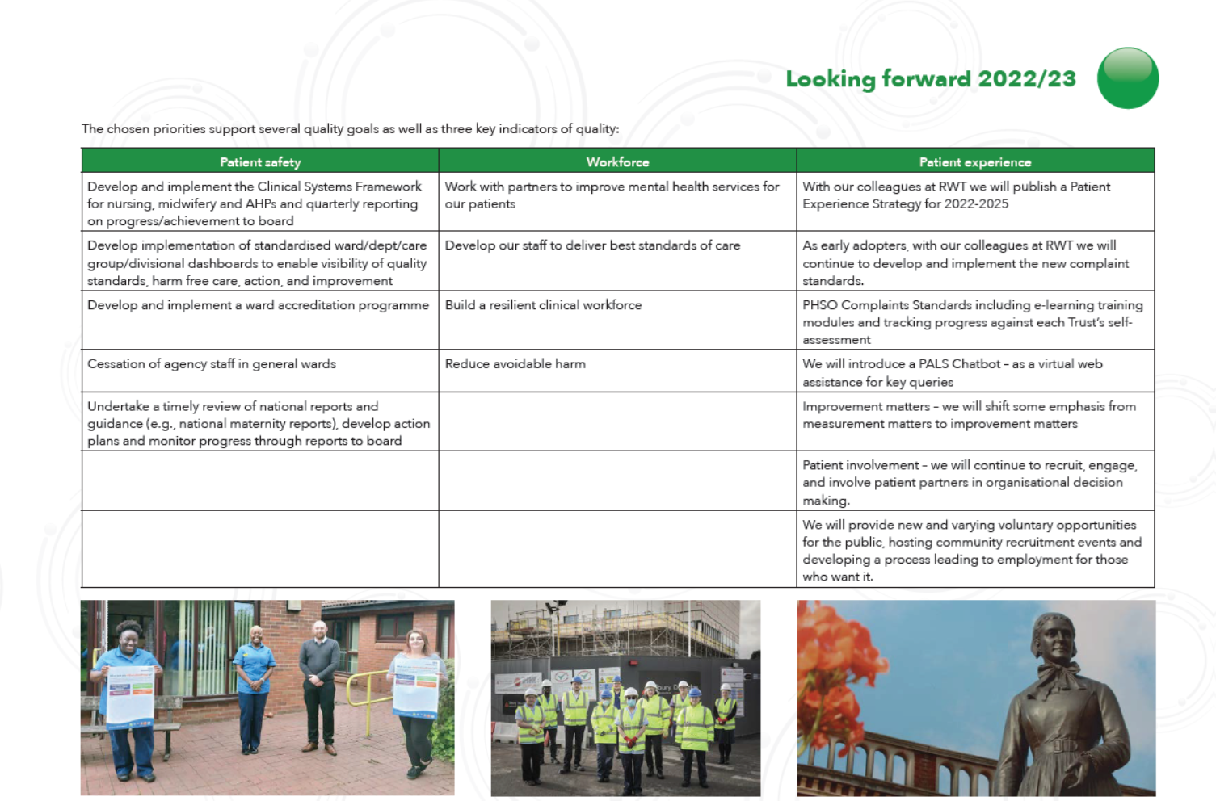
Quality priorities 2022/23 – looking back

Slide 14
How did we do? – Patient Safety
Quality priority | Progress
Develop and implement the Clinical Systems Framework for nursing, midwifery and Allied Health Professionals and quarterly reporting on progress/achievements to board | The Quality Framework was launched on 3 April 2023. Quarterly reporting against the planned milestones will be implemented from the end of Q1 2023/24
Develop implementation of standardised ward/department/care group/divisional dashboards to enable visibility of quality standards, harm free care, action and improvement | Work has been undertaken to develop dashboards with visibility from ward to board. During 2023/24, quality boards will be standardised in all clinical areas to ensure visibility of data and actions being taken
Develop and implement a ward accreditation programme | A clinical accreditation programme was piloted in 2022/23 and has launched across the Trust in April 2023
Cessation of agency staff in general wards | The Trust has ceased agency use except in exceptional circumstances from 31 March 2023
Undertake a timely review of national reports and guidance (e.g., national maternity reports), develop action plans and monitor progress through reports to board | The Trust has reviewed national reports and guidance such as the Ockenden Report 2022, developed action plans and is reporting on progress through the Quality Committee

Slide 15
How did we do? – Workforce
Quality priority | Progress
Work with partners to improve mental health services for patients | Worked in partnership with RWT to develop a best-in-class approach to mental health services for our patients Appointed a lead mental health nurse and developed a comprehensive training and development programme for our staff Worked with partners to make improvements to the system of care and provide support to staff and patients
Develop our staff to deliver the best standards of care | Invested in education, development and training for all staff to improve care and with an improved staff experience rating from external regulators and internal validation by survey Invested in our health and wellbeing offer to staff to improve staff experience A series of quality away days for senior nurses, midwives and AHPs have been held during 2022/23
Build a resilient clinical workforce and reduce avoidable harm | Eliminated reliance on agency and locum resource by recruiting to revised establishments following a biannual skill mix review Appointed a fully substantive workforce across all work groups and achieved vacancy rates of three percent or below for clinical workforce, Nursing, Midwifery and Medical Increased the clinical establishment and support roles by establishing new routes to employment, including Clinical Fellows Improved performance against all quality and safety indicators in-year including reducing harm and improving the infection prevention rating to green

Slide 16
How did we do? – Patient experience
Quality priority | Progress
With our colleagues at RWT we will publish a patient experience strategy for 2022-2025 | We published our joint Patient Experience Enabling Strategy
As early adopters, with our colleagues at RWT we will continue to develop and implement the new complaint standards | Adopted the model complaint handling procedure and produced training modules to support
Parliamentary and Health Service Ombudsman (PHSO) Complaints Standards including e-learning training modules and tracking progress against each Trust’s self-assessment | Undertaken a full review of templates to ensure compliance with the standards and completed the NHS assessment matrix.
We will introduce a Patient Advice Liaison Service (PALS) Chatbot – as a virtual web assistance for key queries. | We have scoped the market and have decided to develop an in-house tool and this development is ongoing
Improvement Matters – we will shift some emphasis from measurement matters to improvement matters | We have embedded the “reflective shoes” process within our complaint process.
Patient Involvement – we will continue to recruit, engage, and involve patient partners in organisational decision making | Patient partners have been involved in the development and co-design of new ward information boards Our partners have been involved in faith-based improvements, PLACE assessments, quality improvement work and action monitoring in response to national surveys.
We will provide new and varying voluntary opportunities for the public, hosting community recruitment events and developing a process leading to employment for those who want it | Strengthened existing partnerships with Juniper Training and Manor Farm Community Centre and developed new partnerships with St John Ambulance and NHS cadets

Slide 17
Our Quality priorities for 2023/24 – looking forward
Patient safety | Clinical effectiveness | Patient experience
Embed a culture of learning and continuous improvement at all levels of the organisation. | The right workforce with the right skills, in the right place at the right time | Embed a culture of learning and continuous improvement at all levels of the organisation.
Deliver safe and responsive urgent and emergency care in the community and in hospital. | Prioritise the treatment of cancer patients, focusing on improving outcomes for those diagnosed with the disease
Embed a culture of learning and continuous improvement at all levels of the organisation. | Deliver the priorities of the National Elective Care Strategy

Slide 18
Finance Report 2022/23
Kevin Stringer,
Group Chief Finance Officer

Slide 19

Trust Finances 2022/23
Annual Report
– Financial Statement on pages 51 to 52
Annual Accounts and notes
– ‘Financial Performance Targets’
notes on pages 138 to 150
Key messages
– A challenging year with pressures to increase the pace of elective recovery and deal with pressures that remain from the Covid-19 pandemic. The Trust still managed to achieve its break-even duty in year and make significant capital investment in a brand new Urgent and Emergency Care Centre.

Slide 20
Financial Performance
Income and Expenditure | Actual £0.4m surplus (after technical changes)
Breakeven Performance (To break even ‘year on year’) | Improved cumulative position to £61.3m deficit
External Financing Limit (Target = not to overshoot) | Achieved
Capital Resource Limit (Target = not to overshoot) | Achieved Spend of £41.9million
Closing Cash Balance | £38.4m
BPPC Performance | 91.1% value and 89.2% volume (Target 95%)
Accounts were fully audited by Mazars and represent a true and fair view of the organisation's financial performance
Thanks to the Board, our commissioners and our budget managers. Special thanks to local residents and businesses.

Slide 21
Financial Performance
Summary Financial Performance
SUMMARY FINANCIAL PERFORMANCE FOR THE YEAR TO 31 MARCH 2023
Description | £m’s
Income | 401.7
Expenditure | (418.3)
OPERATING SURPLUS | (16.6)
Non Operating Costs (Interest/PDC) | (10.3)
Impairments | 27.1
Donated assets | 0.2
SURPLUS FOR THE YEAR | 0.4

Slide 22
Financial Performance
Income
NHS income comprises of:
1 – Black Country Integrated Care Board: £325.8m
2 – NHS England: £41.4m
3 – NHS Providers: £1.8m
Please note: -
Examples of other income are trading income, injury cost recovery scheme and training

Slide 23
Financial Performance
Expenditure
Examples of other expenditure include, Education and Training, Auditors, car parking, security and transportation.

Slide 24
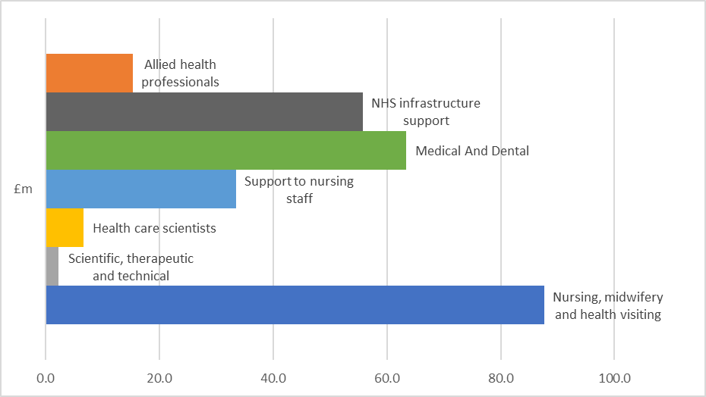
Financial Performance
Expenditure – Staffing Costs
Staff Group | £m
Nursing, midwifery and health visiting | 87.7
Allied health professionals | 15.3
Scientific, therapeutic and technical | 2.2
Health care scientists | 6.7
Support to nursing staff | 33.5
Medical And Dental | 63.4
NHS infrastructure support | 55.7
TOTAL | 264.5
Increase in staffing spend of 12.4%. There are a broad range of staff groups, with Medical and Nursing staff accounting for over 57%

Slide 25
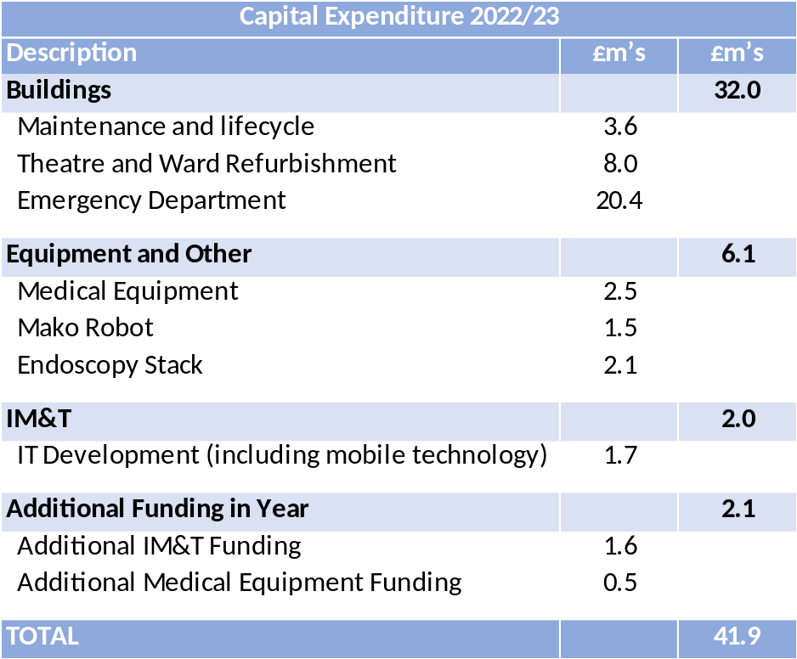

Financial Performance
Capital
Significant capital investments have been undertaken during 2022/23 covering a range of areas.
Completion of the £40.5m new Urgent and Emergency Care Centre.
Major equipment replacement, including Mako
robot, endoscopy stack and CT Scanner

Slide 26
Looking forward to 2023/24 and beyond
The finances remain uncertain due to:
Resources for 2023/24 being significantly constrained across the NHS.
The Black Country Integrated Care System funding allocation remains above the fair share (funding formula) and therefore growth will be restricted.
The planned and forecast deficit for 2023/24 will need to be recovered over future years.
Inflation pressures will impact the cost of undertaking additional work to tackle the backlog of elective activity, and to deliver capital schemes within budget.
Sufficient workforce availability to staff the additional capacity requirements
The cost and provision of social care having an impact on fit to discharge patients

Slide 27
Questions

