Slide 1
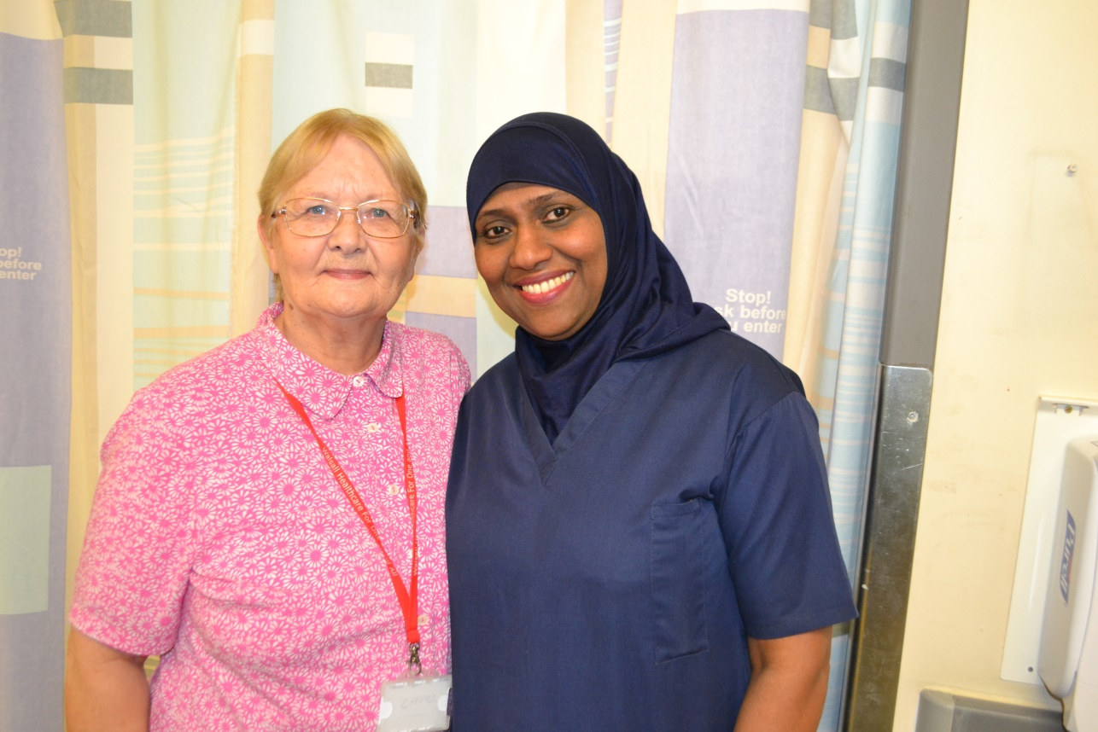

Equality and Inclusion Annual Report 2019-20

Slide 2
Accessibility and Communications
Walsall Healthcare is keen to ensure that our patients, service users, carers, public, staff and partner organisations are aware that reasonable steps are taken to ensure that the information we produce is accessible to a range of individual needs. This also applies to the way we communicate.
This includes; identifying and reasonably removing ‘barriers’ for people accessing our information, services, premises, any employment or engagement opportunities and considering requests for reasonable adjustments as appropriate.
If you would like to receive material from Walsall Healthcare websites or our key publications in another format – such as Audio, Clear Information, Easy Read, British Sign Language, Interpreter
Services, Large Print, or Braille – please contact the general reception number 01922 721 172 and request to speak to the Patient Relations Team.
This Accessibility and Communications Statement will be reviewed annually.

Slide 3
Contents
Accessibility and Communications……………………………………………….
Executive Summary…………………………………………………………………
Introduction………………………………………………………………………
Our vision and values ……………………………………………....................
Equality legislation and our legal duties…………………………………….......
Governance………………………………………………………………………
Progress against our equality objectives………………………………………
Other achievements………………………………………………
Equality, Diversity and Inclusion NHS Mandated Standards…………………..
Patient Experience…………………………………………………
Patient complaints – Equality monitoring…………………………………………
Looking ahead to 2020/21……………………………………………………
ANNEX A Workforce equality information……………………………………
………………………………………………………………....

Slide 4
Executive Summary
Walsall Healthcare NHS Trust is pleased to present it’s annual equality and inclusion report for 2019 -20.This report has been developed to showcase the work that has been undertaken over the past twelve months to demonstrate compliance with the Public Sector Equality Duty.
The report highlights the Trust’s commitment to continuous improvement with equality, diversity and inclusion for the benefit of staff and the patient population of Walsall.
2019 has been a year of change and opportunities for the Trust as the organisation continues to transform ways of working following a number of recommendations from the CQC inspection in February 2019.A robust improvement framework has been introduced along with comprehensive action plans as part of the Trust’s transformation journey to achieve an Outstanding CQC rating by 2022.
In early 2019, the Trust developed an equality, diversity and inclusion strategy to support improvements in equality, diversity and inclusion across the organisation. The Trust Board also signed up to a Board Pledge to demonstrate their commitment to a zero tolerance approach to inappropriate behaviour in the workplace and treating people fairly, and inclusively.
This report provides information about progress made with the Trust’s Equality, Diversity and Inclusion objectives and compliance with the Gender Pay Gap reporting , NHS Mandated standards such as the Workforce Disability Equality Standard, Equality Delivery System 2 and Workforce Race Equality Standard.

Slide 5
Introduction
Walsall Healthcare NHS Trust provides local general hospital and community services to around 270,000 people in Walsall and the surrounding areas. We are the only provider of NHS acute care in Walsall, providing inpatients and outpatients at the Manor Hospital as well as a wide range of services in the community. Walsall Manor Hospital houses the full range of district general hospital services under one roof. The £170 million development of our Pleck Road site was completed in 2010 and the continued upgrading of existing areas ensures the Trust has state of the art operating theatres, treatment areas and equipment.
We provide high quality, friendly and effective community health services from some 60 sites including Health Centre’s and GP surgeries. Covering Walsall and beyond, our multidisciplinary services include rapid response in the community and home-based care, so that those with long-term conditions and the frail elderly, can remain in their own homes to be cared for.
The Trust’s Palliative Care Centre in Goscote is our base for a wide range of palliative care and end of life services. Our teams, in the Centre and the community, provide high quality medical, nursing and therapy care for local people living with cancer and other serious illnesses, as well as offering support for their families and carers.
Walsall Together is an ambitious and exciting programme to transform health and social care provision in Walsall. The programme brings together all the local NHS organisations in the Black Country and its vision is to address the changing needs of our population with integrated care solutions that maximise the potential of the individual person, the teams that support them and the wider health and care system.

Slide 6

Our vision and values
Walsall Healthcare NHS Trust is guided by five strategic objectives which combine to form the overall ‘vision’ for the organisation.
Complementing this are our ‘values’, a set of individual behaviours that we wish to espouse amongst our workforce in order to deliver effective care for all. We recently revised our vision to reflect our ambition to be ‘Outstanding by 2022.’
Our vision is underpinned by five strategic objectives which are to:
Provide safe, high-quality care – we aim to deliver experience in care as measured
by the CQC rating of ‘Outstanding’ by April 2022.
Deliver care at home – by providing the right care in the right place at the right
time; supporting the people of Walsall to live longer and at home, reducing
reliance on acute care.
Work with partners – we will work in partnership to improve health and well-being.
Value our colleagues – We are aiming to be an inclusive organisation which
lives our organisational values at all times (Respect, Compassion, Professionalism & Teamwork).
Use resources well – to utilise our resources to their optimum in order to deliver best value.

Slide 7

Our vision and values
Our ambition is that by 2021 we will be an organisation that is focused on delivering safe care closer to the homes of the communities we serve; have a workforce that is engaged and empowered and we are working with partners to ensure our financial sustainability.
As well as revising our vision, we engaged with colleagues to agree on the values and individual behaviours that we wish to espouse in our working environment.
Respect- We are open, transparent and honest, and treat
People with dignity and respect
Compassion- We value people and behave in a caring, supportive
and considerate way
Professionalism- We are proud of what we do and are motivated to
make improvements
Team work- We understand that to achieve the best outcomes we
must work in partnership with others
These values and the behaviours that underpin them have recently
been incorporated into our revised Performance and Development Review paperwork.

Slide 8
Equality legislation and our legal duties
Equality Act 2010 & Public Sector Equality Duty 2011
What is the Public Sector Equality Duty (PSED)?
The equality duty was created by the Equality Act 2010 and replaced the race, disability and gender equality duties. The duty came into force in April 2011 and covers the nine protected characteristics which are age, sex, disability, race, religion and belief, gender reassignment, sexual orientation, pregnancy and maternity and marriage and civil partnership status. It applies in England, Scotland and Wales. The general duty is set out in section 149 of the Equality Act. These are sometimes referred to as the three aims or arms of the general duty. The Act explains that having due regard for advancing equality involves;
Removing or minimising disadvantages suffered by people due to their protected characteristic
Taking steps to meet the needs of people from protected groups where these needs are different from the needs of other people
Encouraging people from protected groups to participate in public life or in other activities where their participation is disproportionately low.
The Act states that meeting different needs involves taking steps to take account of disabled people’s disabilities. It describes fostering good relations as tackling prejudice and promoting understanding between people from different groups. It states that compliance with the duty may involve treating people more favourably than others e.g. disabled people.

Slide 9

Equality legislation and our legal duties
Public authorities also need to have due regard to the need to eliminate unlawful discrimination against someone because of their marriage or civil partnership status. This means that the first aim of the duty applies to this characteristic but that the other aims advancing equality and fostering good relations) do not apply.
There are two ways that a body can be subject to the general equality duty. Those bodies listed in schedule 19 of the Equality Act 2010 are subject to the general duty. In addition, any organisation which carries out a public function is subject to the general duty.
The general duty requires public authorities to have due regard to the need to eliminate discrimination; advance equality of opportunity, and foster good relations when making decisions and developing policies ( i.e. in all their planning and decision making) In order to meet the legal duty, it is necessary for organisations to understand the potential effects of its activities on different groups of
people.
Where these are not immediately apparent, it may be necessary to carry out
some form of assessment or analysis to understand any potential negative
Impact on protected groups e.g. age, disability, religion and belief, sexual
orientation, marriage and civil partnership status, gender reassignment,
race, sex, pregnancy and maternity.

Slide 10

Equality legislation and our legal duties
Brown and Bracking principles- Due regard
There are many cases in which the courts have considered whether a body has complied with the public sector equality duty and the former equality duties for race, gender and disability. The principles set out in those cases will be relevant to the duty under s.149 in R (Brown) v. Secretary of State for Work and Pensions 2008. The court considered what a relevant body has to do to fulfil its obligation to have due regard to the aims set out in the general equality duty. The Brown principles it set out have been accepted by courts in later cases. Those principles are that;
The equality duty is an integral and important part of the mechanisms for ensuring the fulfilment of the aims of anti discrimination legislation.
The duty is upon the decision maker personally. What matters is what he or she knew.
A body must assess the risk and extent of any adverse impact and ways in which such risk may be eliminated before the adoption of a proposed policy.

Slide 11
Governance
Walsall Healthcare has mechanisms in place to ensure that equality, diversity and inclusion is monitored and reported on through its governance structures.
People and Organisation Development Committee-PODC
This group is chaired by a non Executive Director and member of the Trust Board and meetings take place once a month. The purpose of the group is to provide strategic direction on all matters related to People and Organisation Development which includes equality and inclusion. Progress is reported to the Board on a regular basis.
Equality Diversity and Inclusion Committee- EDIC
This group has responsibility for ensuring the development and delivery of the Trust’s Equality, Diversity and Inclusion agenda and to provide assurance that Trust acts in accordance with its statutory duties to eliminate unlawful discrimination, advance equality of opportunity and foster good relations between those that share a protected group and those that do not.
Patient Experience Committee- PIC
This group has been established to ensure the involvement of community groups and patient
representatives in the design of services.

Slide 12
Governance
Trust Board
People and Organisation Development Committee
Equality and Diversity Committee
Patient Experience Committee

Slide 13
Progress against our equality objectives
The following progress has been made;
The Trust carried out an assessment of equality, diversity and inclusion performance using the Equality Delivery System2 and published the outcomes on the website. This exercise was undertaken with full involvement from members of the local community.
The Trust reviewed its approach to managing equality and inclusion risks .The EIA framework is due to be incorporated into the VERTO platform an online project management tool to ensure there is sufficient governance around equality and inclusion risks.
The Trust has improved its approach to interpretation and translation services to ensure seamless and accessible communication methods for patients whose first language is not English and for patients with a hearing impairment.
The Trust ensured equality and inclusion demographic questions were incorporated into the Medway electronic patient records system to record important patient demographic information. The importance of capturing patient demographics has been incorporated into the EPR training programme.
The Trust’s values have been included within the new Performance and Development Review paperwork to allow staff to demonstrate how they ‘live the values’ in the working environment.
Published WRES,WDES and Gender Pay gap reports on the Trust’s website along with action plans and became a partner in the NHS Employers Equality, Diversity and Inclusion Programme.
Supported our Black and Minority Ethnic Staff to attend the Stepping Up Positive Action programme

Slide 14
Other achievements
Princes Trust
Over the past year we have continued to work with the Prince’s Trust to offer opportunities to young people (aged 16-30) to move into health and social care careers, apprenticeships or learning pathways between 2020 and 2024. The Princes Trust programme is made up of the following:
Get Into
Get Started
Mentoring programmes
The programmes run for 4 weeks, a short course of 3 days or for a day a week for 12 months.
We support the programme by having placements at least 3 times per year. For each programme we aim to find placement opportunities for at least 14 candidates.
Successes to date from the November 2019 cohort include successful candidates:
gaining a Community Support Worker role in the Trust
joining the Clerical Bank and being offered a role within People & Culture directorate
Apprenticeships
A review was carried out with the aim of making improvements to our current apprenticeship offer. For new starter apprentices, the Trust ensured that they were being paid at National Minimum Wage (NMW) for age and removed the apprenticeship hourly rate. Existing employees continue on their current rate of pay for development apprenticeships or move to agreed rate of pay following successful completion of the apprenticeship..

Slide 15
Other achievements
Recruitment to a substantive post – on successful completion of the apprenticeship, competencies and demonstration of the expected Trust values and behaviours ,providing those at risk have been considered and given priority.
Apprenticeship programmes and qualifications more closely linked to area of work
Approved provider list and agreed actions which include regular reviews with line managers
Clear roles & responsibilities for apprentices, managers, providers and support teams
We currently have a total of 118 active apprentices which include existing staff as well as those recruited into apprentice vacancies. This is above the required 2.3% of the total workforce to be apprentices, approximately 103 apprentices per year.
Work experience
We carried out a review of the current Work Experience offer and have made improvements to ensure we have opportunities at all educational levels, as well as offering opportunities for people with Learning & Physical disabilities.
We have established better links with local schools and colleges such as Health Futures UTC in West Bromwich which is a school that caters for young people aged 14-19 who are interested in studying for careers in health, science and social care as well as other organisations that support the development of people who need additional support to gain employment opportunities.

Slide 16
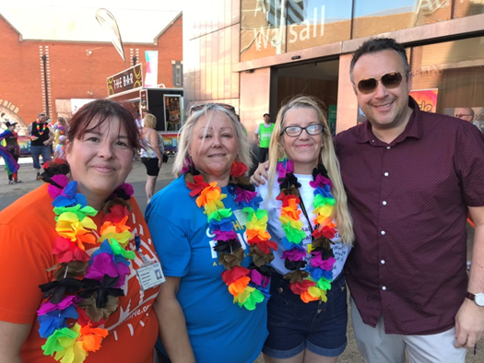
Other achievements
Supporting Walsall Pride
In August 2019, Walsall Healthcare Trust supported Walsall Pride which was attended by the Walsall Integrated Sexual Health team, the Trust’s Communications Officer and Head of Patient Relations.
Engagement with the LGBT+ community is key to ensuring services recognise the needs of this community and that they have confidence in the services provided. A recent Stonewall survey (published November 2018) stated that lesbian, gay, bisexual and transgender (LGBT+) patients face inequalities in their experience of NHS healthcare.
The survey estimates that one in five LGBT+ people are not out to any healthcare professional about their sexual orientation when seeking general medical care, and one in seven LGBT+ people have avoided treatment for fear of discrimination.
To begin to increase awareness and to help improve the experiences for
our LGBT + patients, Walsall Healthcare has signed up to support the
Rainbow Badge initiative. Wearing the badge is a sign that the wearer
is someone you can talk to about issues of sexuality and gender identity.
When staff sign up to wear the badge they are provided with information
about the challenges people who identify as LGBT+ can face accessing
healthcare and what they can do to support them.

Slide 17

Other achievements
Interpretation and language service
The Trust made improvements to its interpreting and translation service and the service is provided by Word 360. Word 360 have partnered up with Communication Plus to deliver communication support across Walsall Healthcare NHS Trust.
Sites include:
Walsall Manor Hospital
Community Health visitors
Physiotherapists and Community nursing
Walsall Council
Dudley & Walsall Mental Health Trust
From January 2020,patients will be able to access translation and interpreting services via a video relay link. As part of the service offer , there are plans to develop an information toolkit to provide information to staff on how to support patients with specific communication needs.
The Patient Liaison team also attended a Healthwatch spotlight event in November 2019 to share information on the support we provide for patients who are hard of hearing or with complete hearing loss who access our services.
The number of patients who require full BSL support has increased steadily from 2017 to 2019 with 419 bookings undertaken compared to 368 when our partner organisation WORD 360 were contracted.

Slide 18

Other achievements
EIDO – Patient information Library
EIDO Healthcare is an evidence-based patient information factsheet library of over 320 leaflets relating to procedures and treatments available nationally. Healthcare staff at the Trust can use EIDO to help patients make around informed consent about their treatment, procedure or care.
Patients need to be fully informed of their treatment and to understand the proposed procedures. High-quality, clear information helps patients' understand the medical procedure and available alternatives only then can they make an informed decision.
During the year we refreshed our information to take into account availability of information for patients where English is not their first language. The library allows staff to search through over 320 patient information leaflets relating to procedures and treatments available nationally. Accessibility requests can also be made to include large print, giant print and screen reader alternatives.

Slide 19

Other achievements
Choose the Right Path initiative- educating young people about the devastating effects of knife crime
The #ChooseTheRightPath event was organised as a partnership between Walsall Healthcare NHS Trust and the James Brindley Foundation.
The foundation was formed in 2018,following the murder of Aldridge man James Brindley who was fatally stabbed in his home town in June 2017.
The event brought together family members and professionals to provide
an opportunity for young people to understand how the choices that they make
can affect both themselves and others, now and in the future.
Local boxers supported the free event which took place on Tuesday 17 September
at Walsall Manor Hospital and a cinema room with free popcorn and refreshments was created.
Borough agencies and organisations were in attendance to talk to young people about career and training opportunities with local sporting stars on hand to promote activities.
The James Brindley Foundation’s belief is that young people, including those at risk of entering the Criminal Justice System, can achieve their full potential and live a crime-free lifestyle with the right support and intervention.

Slide 20
Equality, Diversity and Inclusion NHS Mandated Standards
Equality Delivery System2
The main purpose of the EDS2 is to help local NHS organisations in discussion with local partners and people, review and improve their equality and diversity performance for people protected under the Equality Act 2010.
The EDS2 has four grades and eighteen outcomes; These are grouped under the following four goals:
Goal 1- Better Health Outcomes
Goal 2- Improved patient access and experience
Goal 3- A representative and supported workforce
Goal 4-Inclusive leadership
The EDS2 should be used as a framework to support NHS organisations to highlight any areas for improvement in relation to access to access to services and is a useful tool to enable progress of equality, diversity and inclusion. It is a also a useful tool to support progress with regard to workforce equality and diversity and inclusion.
In 2018, the Trust carried out a comprehensive EDS2 assessment exercise working with local partners and key stakeholders to assess its equality, diversity and inclusion performance. The assessment highlighted a number of identified areas for improvement and an action plan has been developed to address these gaps.

Slide 21
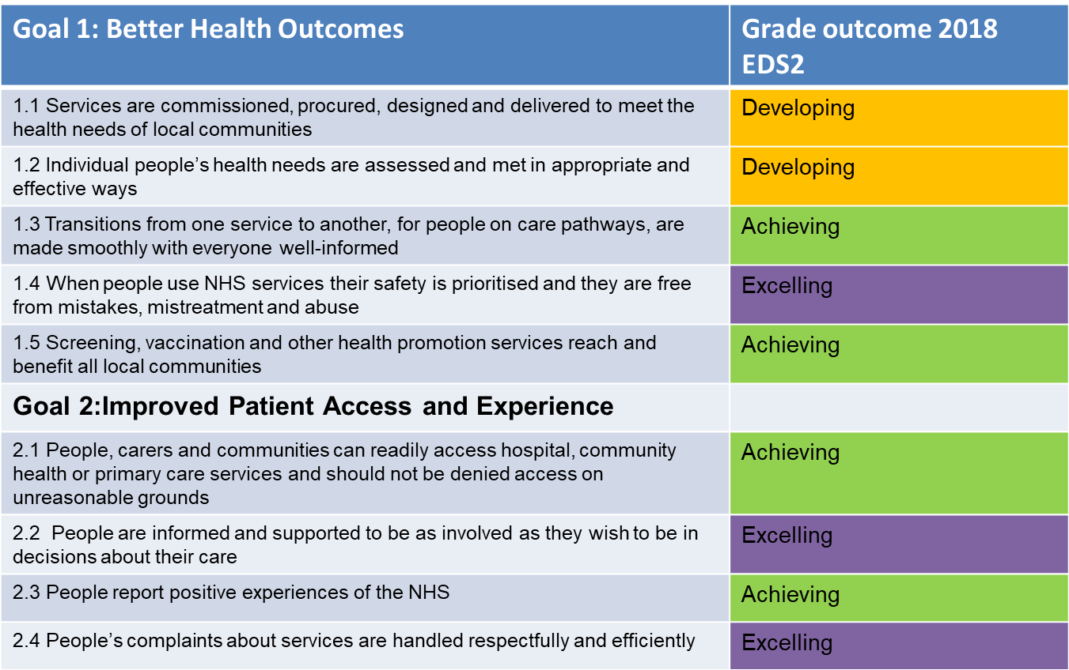
Equality, Diversity and Inclusion NHS
Mandated Standards EDS2 grading summary 2018

Slide 22
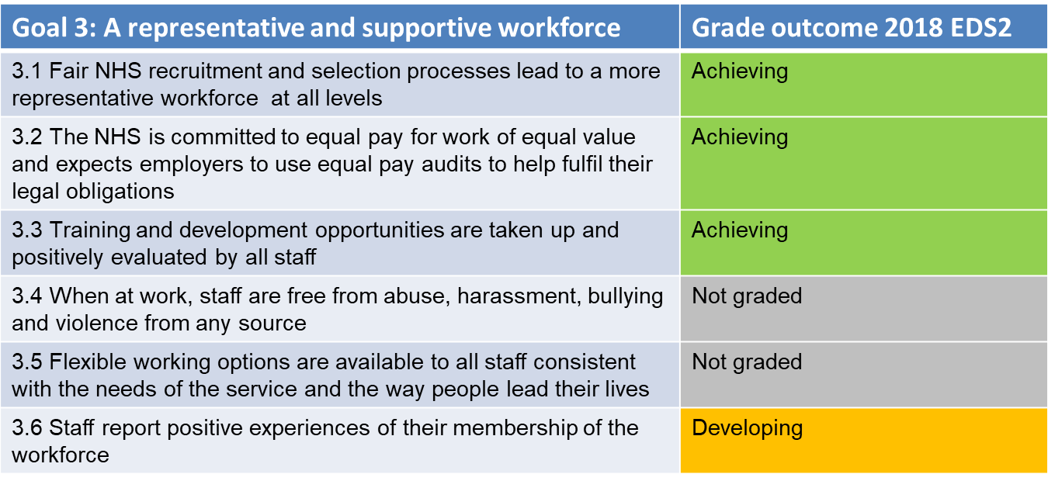
Equality, Diversity and Inclusion NHS
Mandated Standards EDS2 grading summary 2018

Slide 23
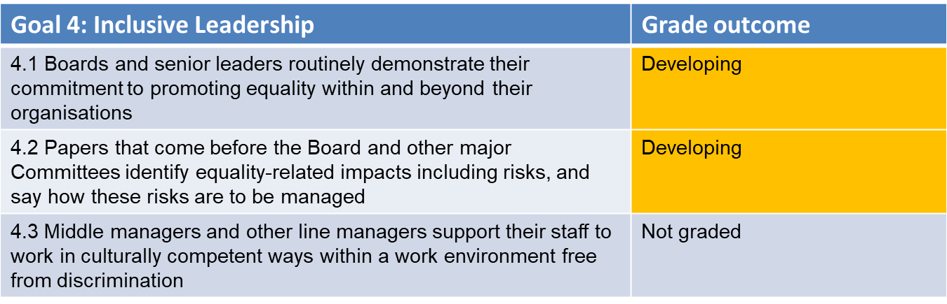
Equality, Diversity and Inclusion NHS
Mandated Standards EDS2 grading summary 2018

Slide 24
Equality, Diversity and Inclusion NHS
Mandated Standards
Workforce Race Equality Standard (WRES)
Since its introduction in 2015, the WRES has required NHS trusts to self assess, annually, on the nine indicators of workforce race equality; these include indicators related to BME representation at senior and board level.
A national WRES team has been established to provide direction and tailored support to NHS trusts, and increasingly to the wider healthcare system , enabling local NHS and national healthcare organisations to:
Identify the gap in treatment and experience between white and BME staff;
Make comparisons with similar organisations on level of progress over time
Take remedial action on causes of ethnic disparities in WRES indicator outcomes
The main purpose of the WRES is to help local, and national , NHS organisations to review their data against the nine WRES indicators, to produce an action plan to close the gaps in workplace experience between White and Black and Ethnic Minority (BME) staff, and to improve BME representation at the Board level of the organisation.
Since the introduction of the WRES, the Trust has reported on the nine workforce indicators and has published this data on the external facing website. This year concerted efforts will be undertaken to ensure significant improvements to the WRES metrics.

Slide 25
Equality, Diversity and Inclusion NHS
Mandated Standards
Workforce Disability Equality Standard (WDES)
The WDES is a set of ten specific metrics that will enable NHS organisations to compare the experiences of disabled and non disabled staff. This information will be used by the relevant NHS organisation to develop a local action plan and enable them to demonstrate progress against the indicators of disability equality.
The WDES is mandated through the NHS Standard Contract. It is restricted to NHS Trusts and Foundation Trusts for the first two years of implementation. There are 10 WDES metrics, which cover such areas as the Board, recruitment, bullying and harassment. Engagement and resources have been developed to prepare and support NHS trusts and Foundation Trusts for the implementation of the WDES, which came into force on the 1st April 2019.
The Trust reported on the WDES for the first time in 2020 and has published the data on its external website along with an action plan to close any gaps between disabled staff experience and non disabled staff.
Accessible Information Standard
The Accessible Information Standard (AIS) aims to make sure that people who have a disability, impairment or sensory loss get information that they can access and understand, and any communication support that they need from health and care services. The Standard tells organisations how they should make sure that patients and service users and their carers and parents can access and understand the information they are given.

Slide 26
Equality, Diversity and Inclusion NHS
Mandated Standards
This includes making sure that people get information in accessible formats. By law, section 250 of the Health and Social Care Act 2012 states that all organisations that provide NHS care or adult social care must follow the Standard in full as of the 1st August 2016 onwards. The Trust has developed an Accessible Information Plan action plan to ensure that the Trust is providing information in accessible formats and progress is being monitored by the Equality, Diversity and Inclusion Committee.
Other legal duties- Health and Social Care Act 2012
The Health and Social Care Act 2012 introduced for the first time, legal duties on health inequalities, with specific duties on NHS England and CCGs, as well as duties on the Secretary of State for Health.
These duties took effect from 1 April 2013.
This meant that the Trust has duties to;
Have regard to the need to reduce inequalities between patients in access to health services and the outcomes achieved
Exercise their functions with a view to securing that health services are provided in an integrated way, and are integrated with health related and social care services, where they consider that this would improve quality, reduce inequalities in access to those services or reduce inequalities in the outcomes achieved
Include in an annual commissioning plan an explanation of how they propose to discharge their duty to have regard to the need to reduce inequalities.

Slide 27
Patient Experience
The Trust continues to listen and act upon the views of its patients, relatives and carers.
The introduction of the new programme of Patient, Carer and Staff Experience Stories to Trust Board, allows patients and staff to attend the Trust Board to give accounts of their experience of care . On occasion a video is shown. This will now also be extended to QPES, Clinician forums and frontline teams
Patient and Carer experience sound bites which are recorded audio feedback continue to be used at the start of the Patient Experience Group and A&E huddle meetings. These bring the patient and carer voice at the heart of what we do and informs potential areas for improvements. There are plans to extend these to Divisional Quality Team meetings after exploring enhancements in audio capture capabilities and resources.
Our Patient Experience programme is supported by our Voluntary service. There are currently 287 volunteers across the Trust undertaking volunteering in a variety of settings and undertaking a variety of activities at the Hospital, Palliative Care Centre, Chaplaincy and the Self Care Management Programme Team. The aim is to continue to grow the number of volunteers undertaking roles in the Trust over the next 12 months and increase the opportunity for people to become volunteers. A target has been set to increase the number of registered volunteers by 10% by recruiting at least a further 30 volunteers throughout 2019-2020. Performance against this target stands at 50% (15 / 30) achieved.

Slide 28
Patient Experience
Friends and Family Test
The NHS Friends and Family Test (FFT) asks patients if they would recommend the services they have used and offers a range of responses from ‘extremely likely’ to ‘extremely unlikely’. Patients are asked: “How likely are you to recommend our service to friends and family if they needed similar care or treatment?” Following extensive consultation and research, changes are expected to take place from 1st April 2020 in the way FFT is carried out. The mandatory question will be clearer and more accessible and will ask ‘Overall, how was your experience of our service?”. There will be six new response options:
Very good
Good
Neither good nor poor
Poor
Very poor
Don’t know
By extracting patient experiences from FFT feedback during Quarter 1 of 2019/20 the main themes arising are Staff attitude, Environment and Implementation of Care. These themes feature in a positive and negative way and are being shared with Divisions to identify the best way to act on the experiences of the patients and to establish priorities.

Slide 29
Patient complaints- equality monitoring
Equality Monitoring
The Patient Relations team issue an equality monitoring form at the point of acknowledgement with 34% (120) returned in 2018/2019.
89% of service users who responded to the survey were white British, the remaining 11% where Indian, Pakistani, Black Caribbean, Bangladeshi, Black British and Irish Gypsy/Traveller
82% of all service users who responded to our survey where age 51 plus (51-60, 61-70, 71-80 and 81 and over.) Only 7.5% where under 30.
67% of service users stated their religion was Christianity, 2.5% Hindi, 2.5% Sikh, 4.2% Islam, and 19% did not wish to say, or had no belief.
65% of responses were received from females, 32.5% men and 2.5% did not wish to state.
87% of patients were heterosexual, 8% bisexual, 5% Gay, 1.7% Lesbian, 1.7% Bi-sexual 5% did not wish to state.
Relationship status was varied, with the highest response being married (53%) single 17%
2.5% were pregnant at the time of making a complaint with a further 2.5% having recently given birth
30% of service users would consider themselves to have a disability.
The data helps the team ensure accessibility is in reach to all communities and the team target hard to reach groups to raise awareness of complaints and feedback mechanisms. Patient Relations Surgeries have been held throughout the last year to increase and widen access.

Slide 30
Looking ahead to 2020/21
Over the next 12 months we will be focused on the following;
Working with the Patient Experience Team we will continue to build partnerships with community groups and local stakeholders including ‘Walsall Local Integration Partnership’.
To ensure that equality, diversity and inclusion continue to be an integral part of our workforce planning to improve patient outcomes and experience.
Provide monthly updates to the Equality Diversity and Inclusion Committee (EDIC) for discussion/action planning and to the People and Organisational Development Committee for assurance.
Finalise robust monitoring arrangements to ensure we collect and analyse data relating to staff with protected characteristics in connection with;
Recruitment
Promotion, Disciplinary Action
Leavers

Slide 31
Looking ahead to 2020/21
The implementation of ‘Values-Based’ recruitment.
Review our Training Needs Analysis to ensure training is linked to workforce planning and a fair process for development opportunities.
Identify ways to encourage and support more female consultants to apply for Clinical Excellence Awards as part of reducing the Gender Pay Gap.
Work to redress recruitment inequity by ensuring a diverse panel that represents our community and workforce, to be achieved through the introduction of a pool of trained staff who can be called upon to sit on panels.
Continue to support and participate in national and local events that embrace diversity.
The development of a systematic approach to talent management to ensure diverse talent pools for the future.
Create an Inclusion Group, which feeds into the Equality, Diversity and Inclusion Committee, with oversight for diverse staff networks.

Slide 32
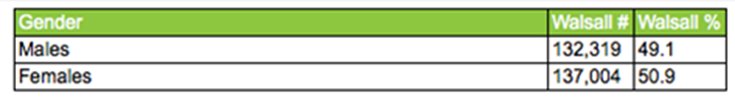
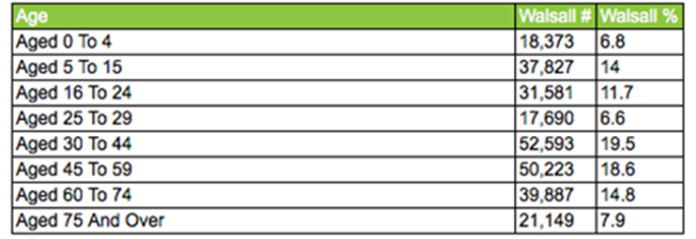
ANNEX A -Workforce equality information
Walsall is a diverse borough; however, there are significant areas of deprivation and differentials in health outcomes across the borough and we are the 30th most deprived borough in England.
Walsall has an estimated population of 269,323 which is higher than the mid-2010 estimates and represents an increase of 4.8%, well above the 2.7% increase for the West Midlands.
Walsall has an over-representation in older age groups, aged 65 and above until around the age of 85, where national levels are higher. This may be as a result of a lower life expectancy in Walsall than nationally.

Slide 33
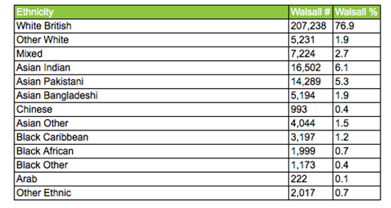
Workforce equality information
Of England’s working population it is reported by NHS Employers that 21% are aged 45 to 54 years and within the NHS as a whole; 28%. The age group 55 to 64 years represents 17% of both England’s working population and the NHS as a whole; whilst those aged 65 and over represent 4% and 2% of England’s working population and the NHS total workforce, respectively.
The ethnic make-up of Walsall is predominantly ‘White British’ at 77%, whilst Black, Asian and Minority Ethnic (BAME) residents represent 27% of our borough’s population with 23.1% from minority ethnic groups.

Slide 34
Workforce equality information
Age
The majority of our workforce is aged between 25 and 54 years of age (74.77% of the workforce) with a median age of 44; this represents a slight decrease from last year in both aspects. The average age in the NHS workforce is reported as 43 years for both men and women.
 | <=25 Years | 26-35 | 36-45 | 46-55 | 56-65 | 66+
WHT | 10% | 23% | 23% | 27% | 15% | 2%
NHS Workforce | 6% | 23% | 24% | 29% | 17% | 1%
England's Working Population | 12% | 23% | 23% | 21% | 17% | 4%

Slide 35
Workforce equality information
The distribution of employees in each of the age categories across pay bands widens with the increase in age. The ageing workforce presents the Trust with both challenges and opportunities; a proportion of the workforce with potentially increasing health issues, but also seeking to retain key skills and experience. With the variations now within retirement provisions and pension rules it is difficult to predict at what point an employee may retire. However, with a large proportion of staff aged over 50 years there is a significant risk to the Trust of losing a high percentage of staff within a relatively short period of time.
The Trust is currently looking at health-related issues affecting people in the workplace that impact on performance and attendance in order to identify any specific trends, including any patterns relating to age and or gender. Further development work will then be done to identify steps or interventions which can be taken in order to support staff further in remaining healthy to support them to be an active part of the workforce, and potentially for longer working lives.

Slide 36
Workforce equality information
Gender
The local Walsall population is equal in gender make up (51% female and 49% Male), whilst the working population of England is 47% female and 53% male.
The Trust has conducted and published a Gender Pay Gap review; the findings of which will inform initiatives aimed at eliminating any difference between the remuneration for men and women.
 | WH Trust Workforce | Local Population | National Working Population | NHS Workforce
Female | 82% | 51% | 47% | 77%
Male | 18% | 49% | 53% | 23%
The overall gender make-up of the Trust workforce is 81.6% Female and 18.4% male. This represents a very small increase in men employed within the Trust and a corresponding small decrease in women employed within the Trust.
Walsall Healthcare NHS Trust is over-represented by women in the workforce as a whole, when compared to both the local communities, individually or combined, and also England’s working population. However, the Trust is only slightly higher in female representation compared to the NHS as a whole (77%), due in part to the number of job roles which are traditionally more likely to be carried out by women.

Slide 37
Workforce equality information
Whilst under-represented within entry-level posts, men employed in these roles are relatively more likely to occupy higher graded posts in the future.
 | Band 1 - 4 | Band 5 - 6 | Band 7 and Above | Very Senior Manager (VSM) | Training Grade Doctor | Career Grade Doctor | Medical Consultant
Female | 87% | 87% | 82% | 40% | 49% | 36% | 25%
Male | 13% | 13% | 19% | 53% | 51% | 64% | 75%
 | Band 7 | Band 8A | Band 8B | Band 8C | Band 8D
Female | 88% | 73% | 62% | 67% | 25%
Male | 12% | 27% | 38% | 33% | 75%
Men have a much higher relative representation within those jobs categorised as Medical and Dental and are not graded within the AFC pay structure.

Slide 38
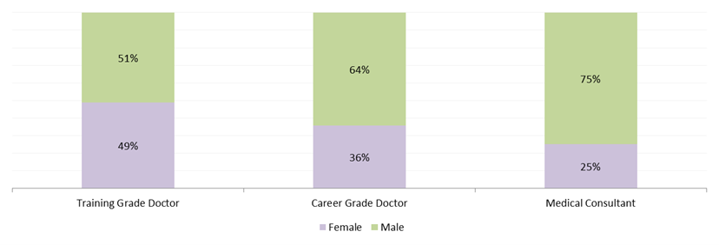
Workforce equality information
Men have a much higher relative representation within those jobs categorised as Medical and Dental and are not graded within the AFC pay structure.
This is generally reflected throughout the whole of the NHS with only 6% of the NHS female staff being doctors and dentists but 22% of NHS male staff occupying the same roles – which considering that men represent 23% of the NHS workforce and women represent 77% indicates a significant under-representation of women in these jobs generally within the NHS, and a similar situation is reflected in the Trust workforce gender/role make up.
Therefore, whilst men are under-represented within the Trust they are more likely, proportionately, to occupy higher graded posts or to be in a Medical and Dental post.

Slide 39
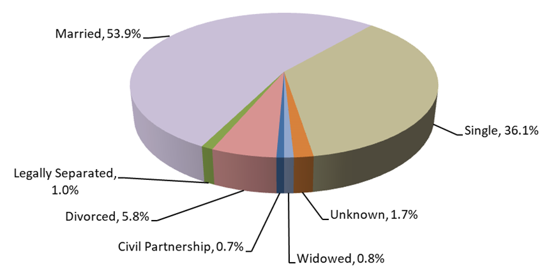
Workforce equality information
Marriage and Civil Partnership Status
The Marriage and Civil Partnership status of colleagues is self-declared via either NHS Jobs, at the point of recruitment, or via self-service using the ESR system. As a result, this information is now not known for only 1.7% of the workforce.
The highest percentage of the workforce have declared themselves as Married (54%); with the second-highest percentage of the workforce declaring themselves as single 36%

Slide 40
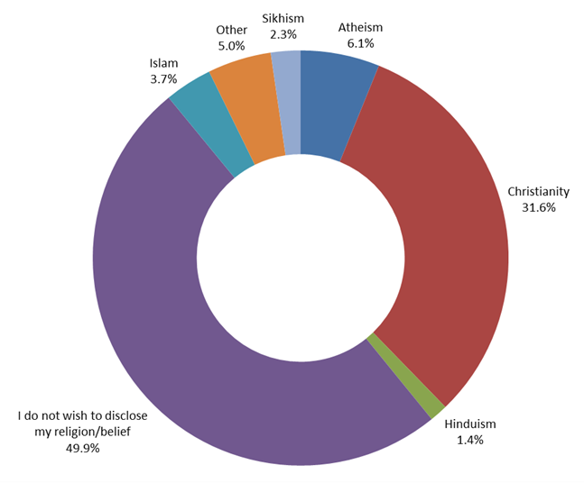
Workforce equality information
Religion and Belief
Christianity is the highest reported Religious Belief by the Trust workforce, with all other Religious Beliefs being reported as very significantly lower – a combined total of 18%.
32% of the workforce declared themselves as having a
Christian belief as compared to the community average of 59%.
The Trust is working with external and internal partners to
understand whether the 50% non-disclosure rate is the result
of active declaration or if this response is the default for
non-declaration.
Further work is being done to actively encourage the workforce
to make full disclosure regarding their protected
personal characteristics via the ESR Self Service Portal
which will enable more detailed reporting in future.

Slide 41
Workforce equality information
Ethnic Background
Reflecting the diverse, multi-cultural community it serves, a colleague working within the Trust represent 54 different nationalities and self-declared 40 separate ethnic backgrounds.
The NHS Workforce Race Equality Standard (WRES) was introduced in 2015 to better understand the links between ethnic background and different experiences within the workplace. The WRES seeks to prompt inquiry and understanding about why BAME colleagues often have poorer workplace experience, compared to than White colleagues, and to facilitate the closing of those gaps.
 | Band 1 - 4 | Band 5 - 6 | Band 7 and Above | VSM
BAME | 20.3% | 22.3% | 5.8% | 0.1%
Non BAME | 79.6% | 58.2% | 25.7% | 0.7%
Not Stated | 0.1% | 0.0% | 0.1% | 0.0%
The 27.5% of overall colleagues declaring themselves as BAME is reflective of local communities; but as the above table illustrates, these demographics aren’t mirrored within leadership positions and higher bands.

Slide 42
Workforce equality information
This pattern is reversed amongst the medical workforce, whereby the vast majority declare BAME origin. This disparity reflects historical medical workforce recruitment, with one-third of medics employed.
The Trust has developed a WRES action plan which is specifically focused on addressing the issues of under representation of BME staff at senior levels in non clinical roles.. A new PDR form has recently been launched which now incorporates a section to capture information about talent and career aspirations. This Information will be used to develop a systematic approach to managing talent to ensure that there are diverse talent pools for the future.
 | Training Grade | Career Grade | Consultant
BAME | 71.3% | 40.6% | 83.2%
Non BAME | 28.0% | 4.2% | 30.1%
Not Stated | 0.7% | 2.1% | 0.0%

Slide 43
Workforce equality information
The Trust collects personal data on sexual orientation in the following categories; Bisexual, Gay, Heterosexual, Lesbian, and ‘I do not wish to disclose’
Sexual Orientation | %
Bisexual | 0.3%
Gay or Lesbian | 0.9%
Heterosexual or Straight | 51.0%
Not stated (person asked but declined to provide a response) | 8.5%
Undeclared | 39.2%
Further work continues to encourage the workforce to make active declarations of all protected personal characteristics, including sexual orientation through self-declaration on the ESR Self Service Portal. The Trust is also committed to the development of inclusive staff networks, working in collaboration with members of the LBGTQ community to create safe spaces and peer support groups.

Slide 44
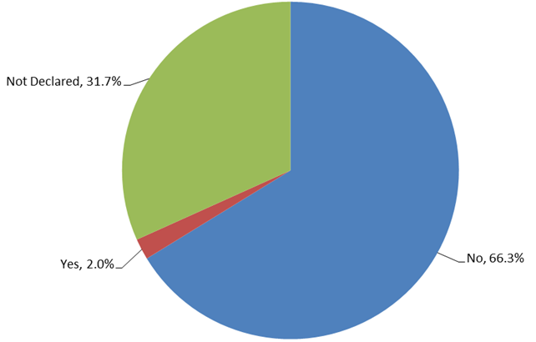
Workforce equality information
Disability, as defined by The Equality Act 2010, describes a disabled person as ….” Someone who has a mental or physical impairment that has a substantial and long-term adverse effect on the person’s ability to carry out normal day-to-day activities.”
The Department of Work and Pensions statistics (2014) show 16% of the working population of England have declared themselves as having a disability. The Disability Research Report and the Workforce Disability Equality Standard Report prepared for NHS England in 2014 explored the issues and measures that a Workforce Equality Standard for Disability should contain. Within this, it was reported that the levels of disability reported in the NHS survey were on average 17% but only 3% recorded as such on ESR.
2% of the workforce declared themselves as having a
disability, with 66% declaring that they have no disability,
and 32% with ‘not declared’ status.

Slide 45
Workforce equality information
Gender Reassignment
Gender Reassignment status is not currently recordable on ESR. NHS England is leading a review of equality standards across the NHS with plans to update the fields within ESR. As information relating to Gender Reassignment is currently not recorded the Trust is looking at ways to ensure that this information can be collated and reported on in the future.

